Slide 1
Modify a Circuit to Measure Current

Slide 2
Modify a circuit to measure current
To measure current flowing through an element, pick an inflow or outflow node, divide the node into two sub-nodes, and insert DMM between the two sub-nodes.
Sometimes the inflow or outflow node cannot be easily divided.
Then you need to modify the circuit by repositioning some elements as needed, and expanding some nodes as needed.

Slide 3
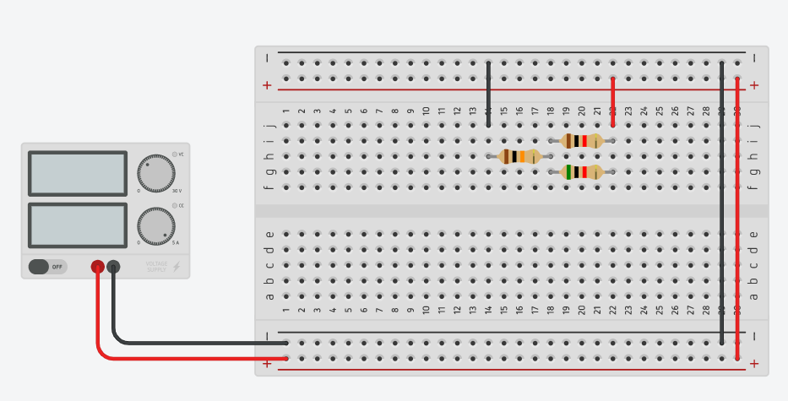
Example circuit
This circuit has a 1k resistor in parallel with a 5k resistor, followed by a 10k resistor in series with the two parallel resistors
Use DMM to measure the current flowing through each resistor
You need to modify the circuit by repositioning the resistors and expanding nodes as needed
Only then can you insert DMMs the usual way in order to measure currents

Slide 4
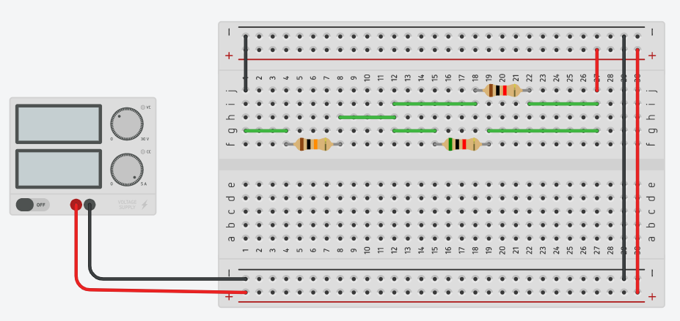
Modified circuit
The original top circuit has been modified into the bottom circuit by repositioning the resistors and expanding nodes as needed
The modified bottom circuit is still the same as the original top circuit, but now we can easily measure current of each resistor

Slide 5
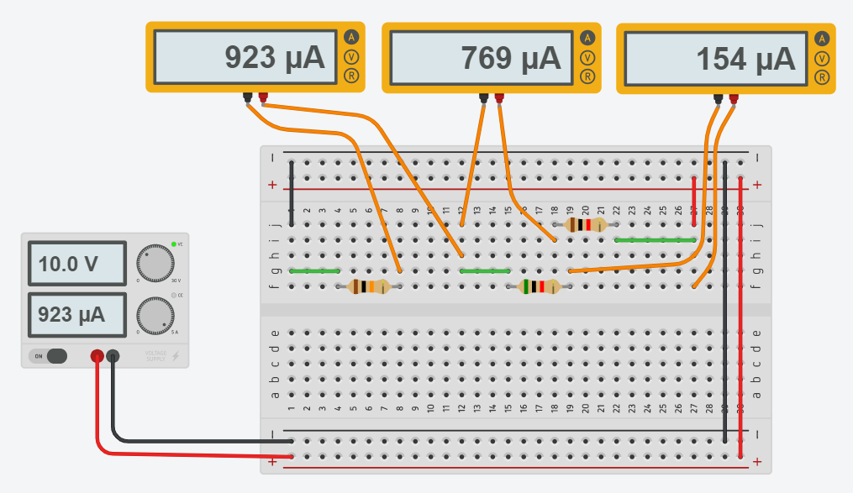
Current measured
For each resistor of the modified circuit, select either an input node or an output node, divide the node into two sub-nodes, and insert a DMM between the two sub-nodes to measure the current
The current values are shown to verify that the measurement is valid

Slide 6
Thank you

